Slide 1
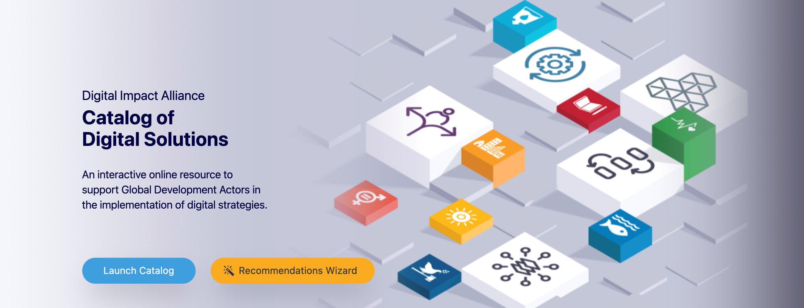
Catalog of Digital Solutions
July 2021

Slide 2
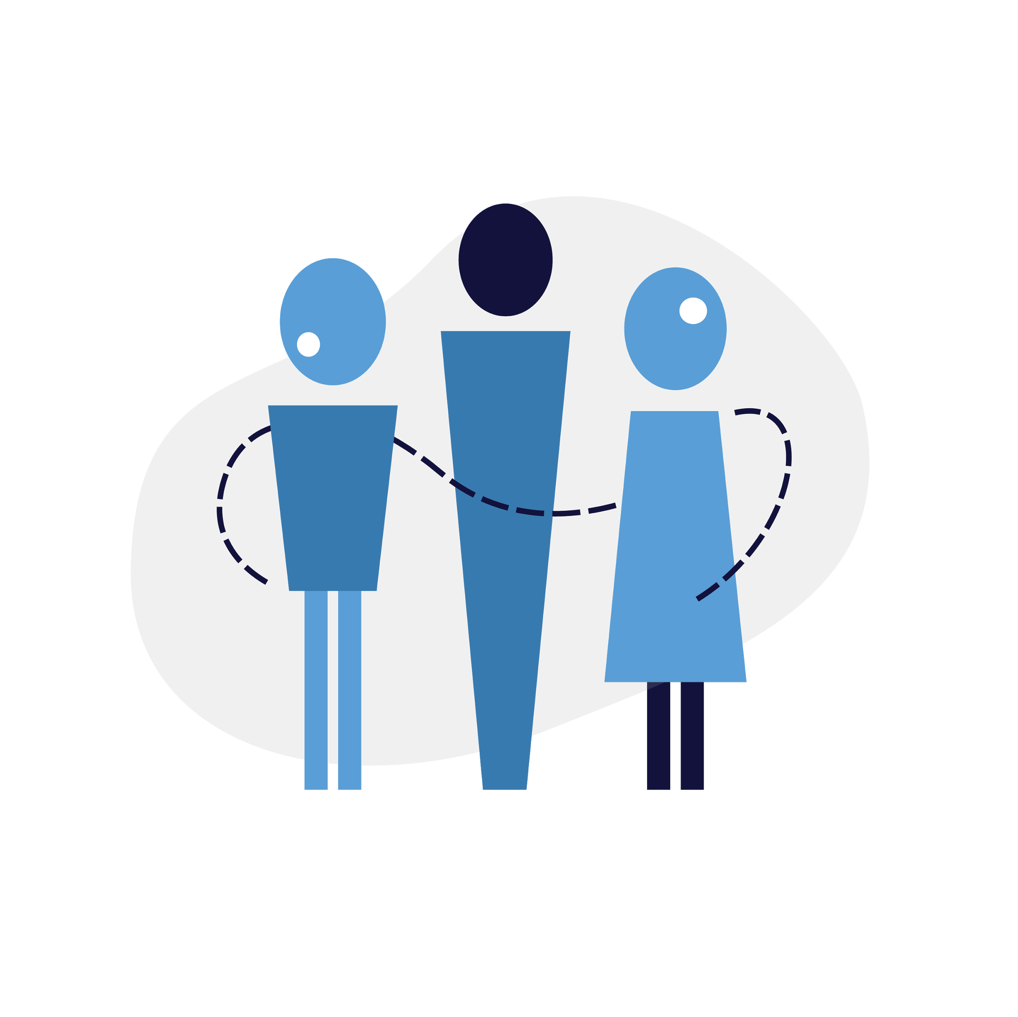
Ecosystem Challenges
DIAL’s goal is to address broad challenges in digital development
The Catalog’s goal is to address fragmentation due to lack access to pertinent information
Policy
Lack of evidence and policy guidance to support “case for digital” and responsible data use
Governments
Coordination between ministries is challenging
Adherence to standards or policies is hard to enforce
There is a lack of tools for tracking investments across a country context of evidence and policy guidance to support “case for digital” and responsible data use
People
Practitioners struggle to incorporate, evaluate and invest in tech effectively
Donors
Investments are often sector-specific with little integration
Hard to coordinate work between project owners or country offices
Product
Duplicative and immature digital and data platforms exist but don’t scale and are rarely reused
Procurers
Missing knowledge and tools on how to evaluate digital technologies
Procurement processes are not standardized
Implementers
Often create bespoke solutions rather than looking for existing tools
Little awareness of how to leverage a building blocks approach to technology deployments
Pricing
Fragmented financing and procurement models for digital hinder greater reach

Slide 3
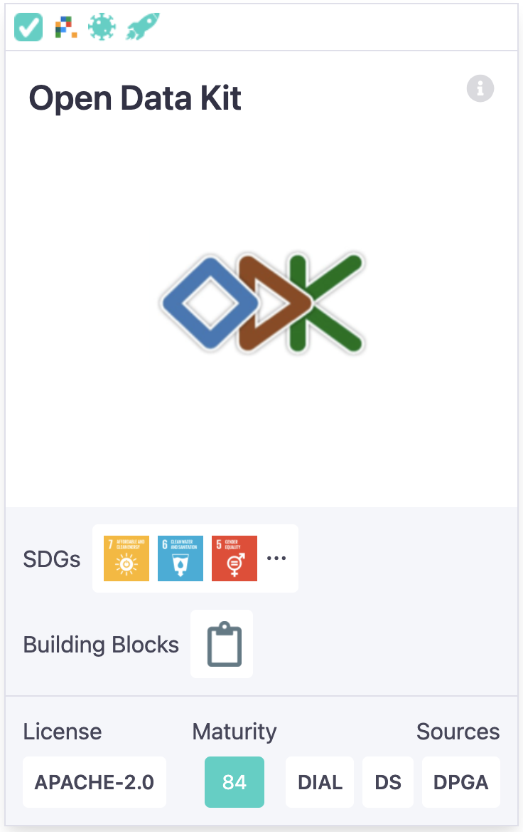
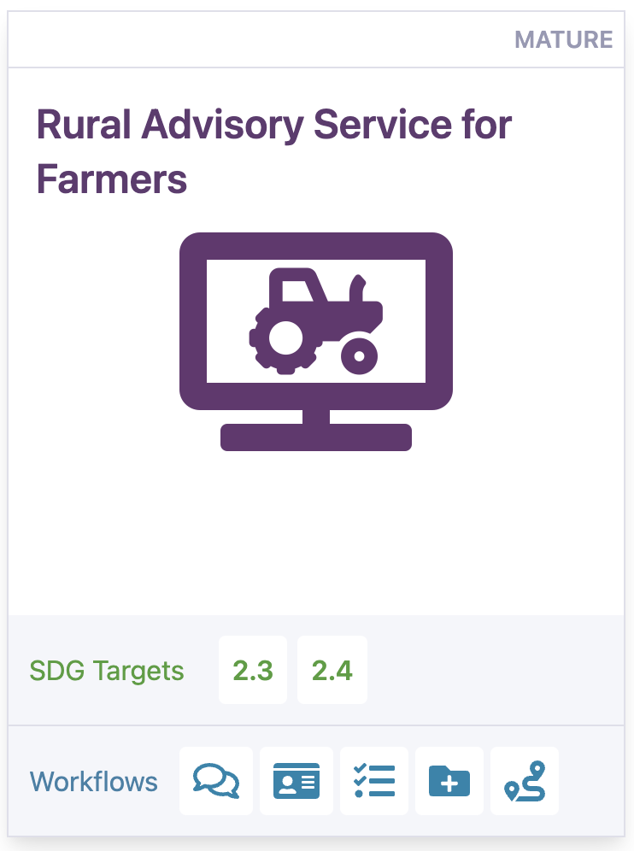
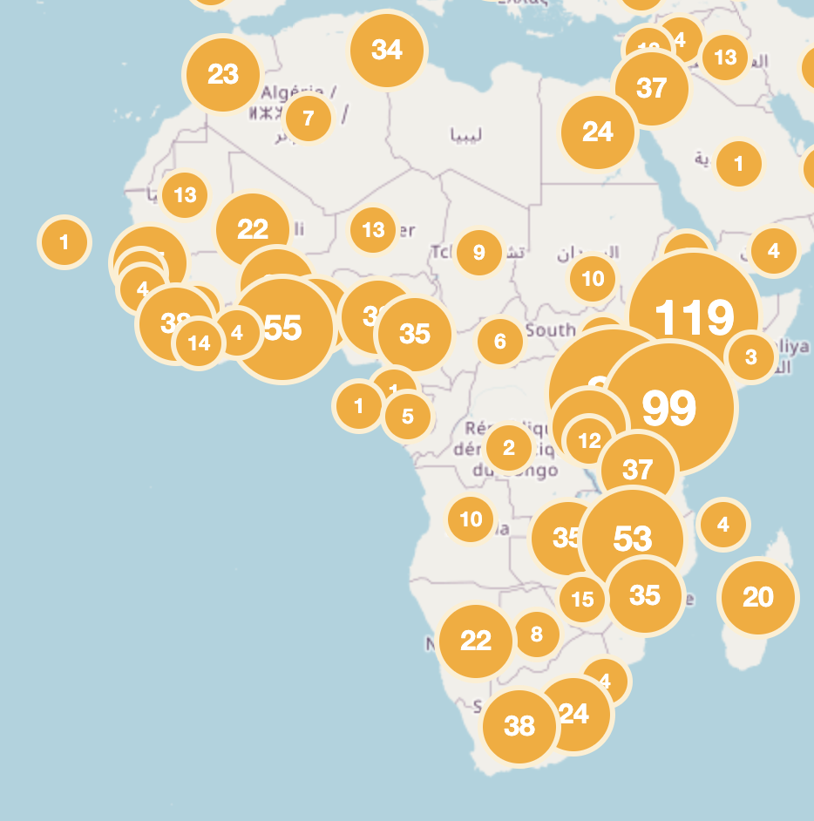
Catalog Vision
https://solutions.dial.community
Discovery
Evaluation
Guidance
Implementations
What products support specific SDGs? What tools already exist in the ecosystem?
Fit: Understand the alignment, maturity, scalability, and sustainability of specific digital tools? What products endorse the principles?
How can I use digital tools to support my project or use case? Instructional content including use cases and playbooks.
Where have products already been deployed and by whom?

Slide 4
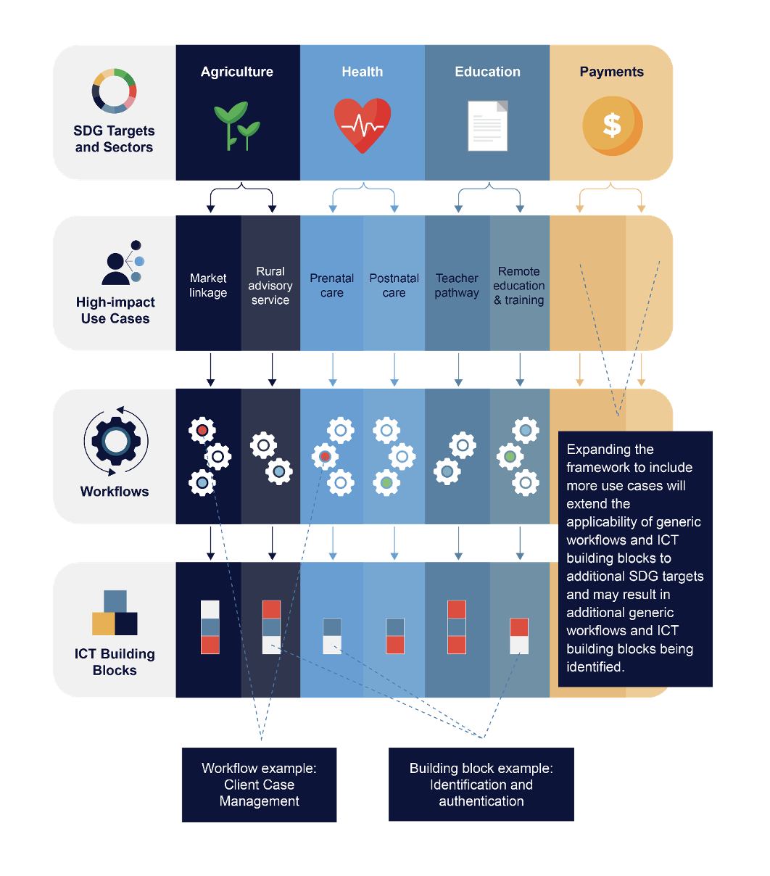
Catalog Vision
Support the SDG Digital Investment Framework
This framework allows us to re-use products and platforms across sectors, reducing fragmentation and enabling greater coordination between organizations.

Slide 5
Catalog Vision
Measure uptake of the Building Blocks approach
The Catalog allows us to track how many users are searching for building blocks and products that are linked to those building blocks.
Starting from an SDG or Target,
Users can develop Use Cases
to achieve these goals.
SDGs
Use Cases across sectors
can be made up of common
business processes or
Workflows
Use Cases
Workflows are composed of
generic Building Blocks, which
implement common functions
Newborn Health
Rural Agriculture Advisory Services
Pandemic Response
Specific Building Block
functionalities can be implemented
by software products. The Catalog
can show products that have been
developed to support key Building
Block functionality.
Workflows
Client Case Management
Knowledge Management
Procurement
Financial Services
Building Blocks
DHIS2
ODK
MOSIP
Mojaloop
Identification
Payments
Messaging
Data Collection
Registration
Products

Slide 6
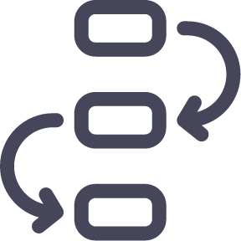
Catalog Vision
Provide insights into real world implementations
Data is sourced from multiple entities, including GIZ, DPGA, WHO, Digital Square, and others
Use Cases
Building Blocks
Products
Organizations
Projects
The catalog contains several detailed use cases providing guidance for specific types of projects. Social protection use case developed in partnership with SPIAC-B
Building Block descriptions and specifications are stored in the catalog and can be linked to specific products so that users can see how products may fulfill building block functionality.
The Catalog provides detailed information on hundreds of digital products and datasets that are oriented around supporting the SDGs. Search for products to fit a specific sector, use case, or building block
Information on over 2900 projects (implementations), including from the GIZ Digital Portfolio. Projects can be searched and filtered by tag, sector, and country
Information on funders, implementers, and organizations that have developed digital platforms. Currently over 600 organizations in the catalog

Slide 7
Product Recommendation Wizard
This new feature allows us to showcase the building blocks approach

Slide 8
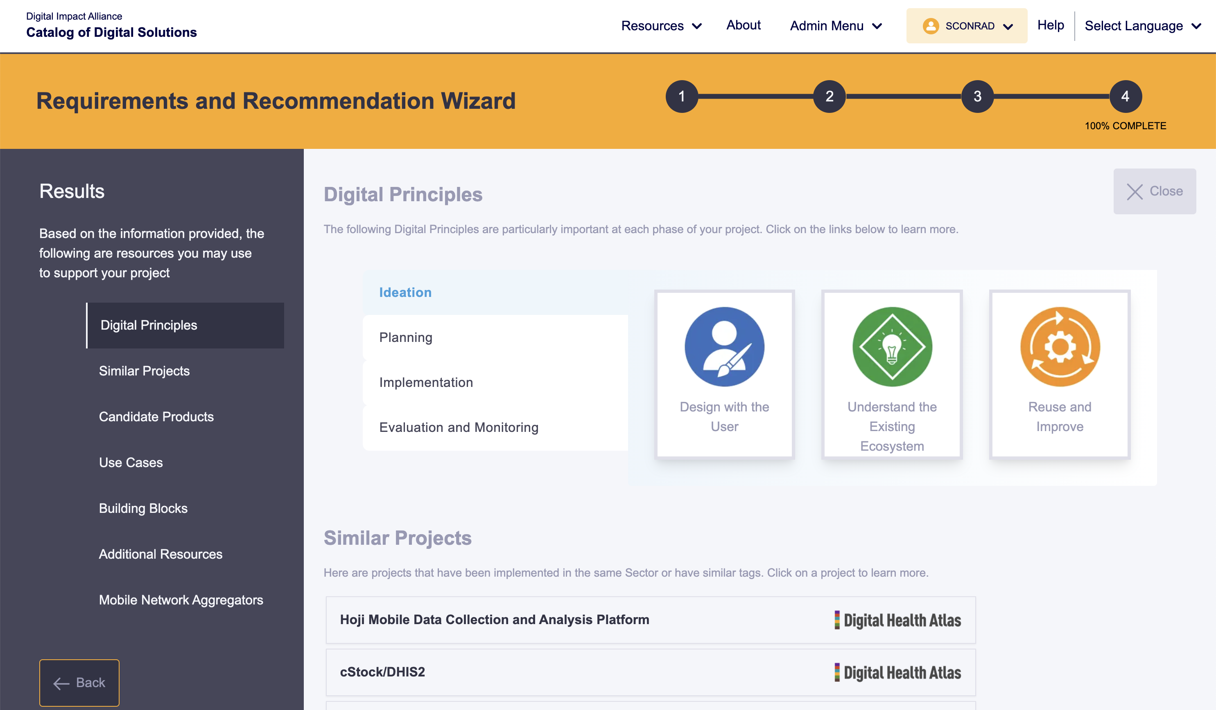
Product Recommendation Wizard

Slide 9
Integrating Data from GovStack
Mapping Building Block Specifications to existing tools
Catalog of Digital Solutions
The Catalog will show the Building
Block specifications developed by GovStack Working groups
The Catalog will have a mechanism
to indicate whether candidate
Products fulfill building block
functionalities and highlight the gaps
Building Block Specifications
Software Platforms/Products
Note: this mapping work will require significant research and investment in 2021-2022.

Slide 10
Strategic Timeline
2021: Q1 & Q2
Future roadmap
UX redesign
Product Recommendation Wizard for intuitive search functionality
Translations into German and French
Data quality: sector mapping
Increased functionality with datasets
Source additional sectoral datasets
Improve Wizard to support more use cases
Data quality: outreach to product maintainers
Discovery
Discourse forum – integration with GovStack WG community
Badges for sourced data, endorsers of Principles, vetted by OSC, etc.
Inclusion of proprietary and commercial products, including licensing framework.
Multi-tenant views for different organization
Development of maturity rubric and product evaluation tools
Evaluation
Guidance
Principles of Digital Development linked through Wizard
Other resources sorted by relevance for project stage
Develop playbooks
Guidance on how to choose between open-source and commercial products
Integrate resource portal
Implementations
Integration of Ag specific data including mappings to Building Blocks
Enhancements of community features for greater discourse between users
Improvements on the map view

Slide 11
Marketing and Promotion
General Marketing
Partner Engagement
Blog posts
Demo video
Screencasts and tutorial videos
Development of marketing toolkit and materials (materials targeted to various user types)
Work with Government of Sierra Leone
Development of committees – governance, product, technical
Development of additional partner relationships (UNDP, BMGF, World Bank)
GovStack Initiatives
Reach out to GovStack partners (Horn of Africa, Estonia)
GIZ leverage catalog to showcase GovStack

Slide 12
Measuring Success and Impact
How do we measure the impact of this platform for donors, implementers, and governments
Uptake by Country Governments.
DIAL is working with the Government of Sierra Leone to leverage the catalog
Identify other Governments/Ministries
GovStack participants – Horn of Africa, etc.
GIZ Country offices and Digital Ambassadors
UNDP Country offices

Slide 13
Thank you

